Slide 1

Predicting Box Office Revenue
Ben Kelly & Kyrylo Khaletskyy
Group 11
CA4010 Data Warehousing & Data Mining

Slide 2
What we have
A Kaggle DataSet with 28 different attributes for each box office movie.
5044 entries.
A range of domestic revenue from $162 - $760,505,847
Applicable attributes for prediction:
Director name
Actor(1,2,3) names
Director total facebook likes
Cast total facebook likes
Budget
IMDB score
Number of faces in poster

Slide 3
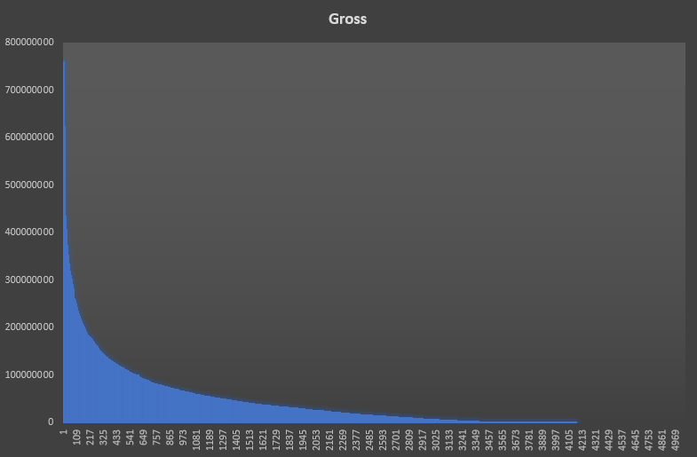
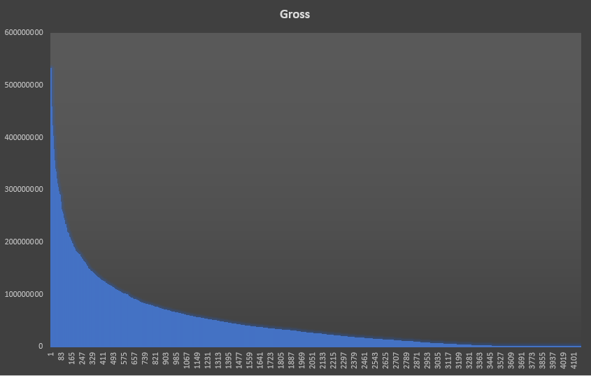
Cleaning Data
Removed attributes not applicable to calculation. (28 down to 11 attributes)
Removed all data with no gross income.
Discarded nulls, outliers and duplicates.
Rearranged order for better visibility.
5,044 down to 4,160 records. (844 null values for gross income)
Before: After:

Slide 4
The Central Tendency
Through graphing our data (scatter plots) we were able to assess if there was any correlation between revenue and any other attribute
We made some preliminary calculations on our gross revenue data
Mean average = $48,468,407.52
Median = $25,517,500
This large difference of figures tell us that there are extreme values (outliers) that are skewing the mean to the right (increasing)
To combat this we calculated the trimmed mean of $42,928,392.60 (2%)
Mode = $3,000,000
Multimodal as Mean - Mode ≠ 3(Mean - Median)
Notes:
Strong group correlation to director of movie and the actors involved
Trimmed = take top & bottom 2%

Slide 5
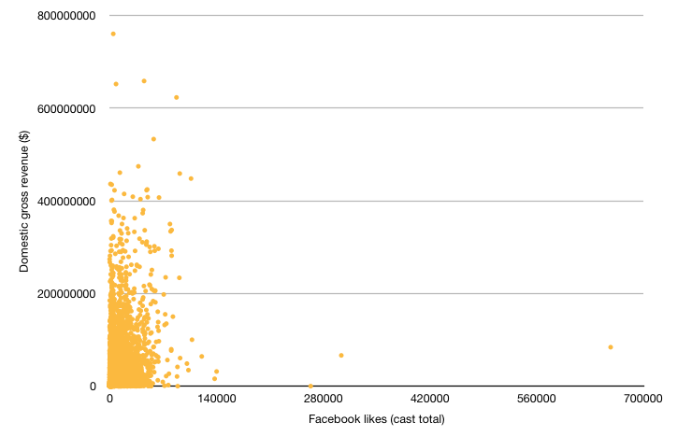
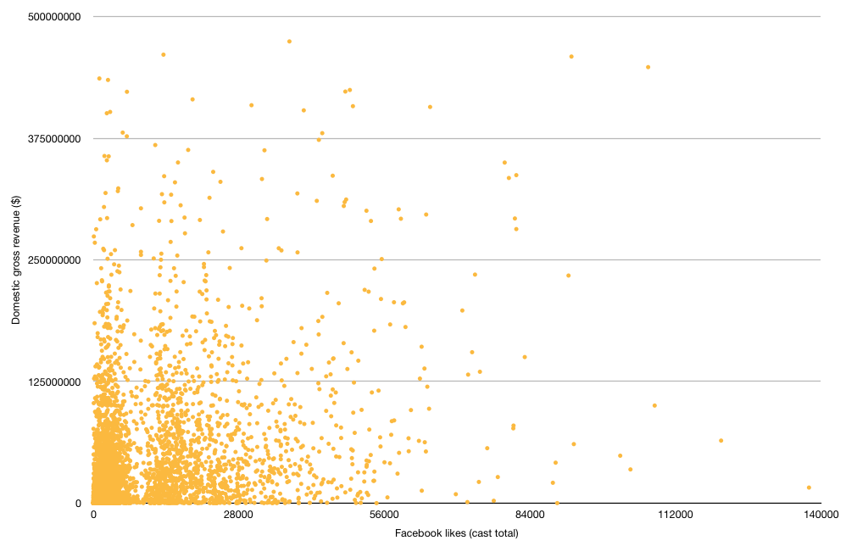
Trimming our data
By trimming the top and bottom 2% of our data for gross revenue we were able to visualize our scatter plots more clearly
Contrary to initial thoughts there is no obvious correlation between FaceBook likes and revenue

Slide 6
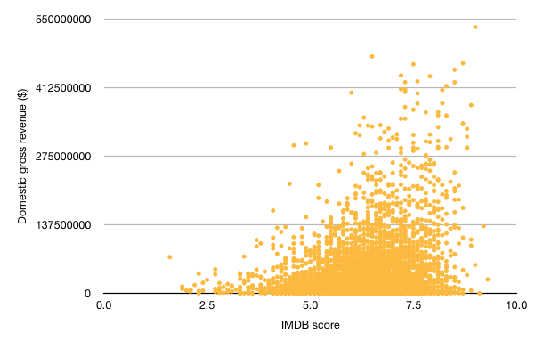
Conclusions made
The strongest correlation we found through scatter plots was between IMDB score and revenue. This is a more useful attribute than originally thought
We will use this further to predict revenue of future movies
We have realised that we will need to categorise our data in order to make
accurate predictions
Our data is skewed right
Strong correlation between the
actors and director of movie

